Slide 1

MICRONAUT
Introduction

Slide 2
PRESENTATION
AGENDA
Introduction
Micronaut Containers: How it Works
Micronaut Introspection
Scopes
Spring Vs Micronaut Annotations
Setup & First Micronaut Application
Micronaut Launch

Slide 3
INTRODUCTION
The Micronaut Framework is a modern, JVM-based Java framework designed for building modular, easily testable JVM applications with support for Java, Kotlin, and Groovy.
The Micronaut framework provides all the tools necessary to build JVM applications including:
Dependency Injection and Inversion of Control (IoC)
Aspect Oriented Programming (AOP)
Sensible Defaults and Auto-Configuration
Current version of Micronaut framework is 4.X.X, released in July 2023.

Slide 4
PRESENTATION
AGENDA
Introduction
Micronaut Containers: How it Works
Micronaut Introspection
Scopes
Spring Vs Micronaut Annotations
Setup & First Micronaut Application
Micronaut Launch

Slide 5
MICRONAUT CONTAINERS: How it Works
Similar to the Spring Framework, Micronaut also provides a container for managing beans and handling dependency injection.
The Micronaut container is designed to minimize startup time, memory usage, and runtime overhead, making it particularly suitable for cloud-native and resource-constrained environments.
Features:
Micronaut AOT, Reflection Free
Fast Startup Time & Low Memory Consumption
Lifecycle Management
AOP (Aspect-Oriented Programming) Support
Cloud-Native Features

Slide 6
PRESENTATION
AGENDA
Introduction
Micronaut Containers: How it Works
Micronaut Introspection
Scopes
Spring Vs Micronaut Annotations
Setup & First Micronaut Application
Micronaut Launch

Slide 7
MICRONAUT INTROSPECTION
Process by which the Micronaut framework analyzes and understands the structure of your application's classes and their dependencies.
Working:
Identifying Key Elements of Application
Annotations like @Singleton, @Controller, @Repository, @ConfigurationProperties
Dependency Graph Generation
Micronaut generates additional classes alongside your own code, creating bean definitions, interceptors, and other artifacts that will enable the DI/AOP behavior when the application is run
Notes:
The Micronaut IoC container implements the JSR-330, and relies on AOT compilation to minimize the use of reflection and reduce application startup time, making it lightweight and compatible with native compilation
Micronaut was designed with microservices and the cloud in mind, while preserving the MVC programming model and other features of traditional frameworks. This is achieved primarily through a brand new DI/AOP container, which performs dependency injection at compile-time rather than runtime.
By annotating classes and class members in your code, you can express the dependencies and AOP behavior of your application using very similar conventions to Spring; however, the analysis of this metadata is done when the application is compiled. At that point, Micronaut will generate additional classes alongside your own code, creating bean definitions, interceptors, and other artifacts that will enable the DI/AOP behavior when the application is run

Slide 8
MICRONAUT INTROSPECTION - CONTD..
Working:
AOT Compilation
During introspection, Micronaut analyzes the dependency graph and generates optimized bytecode for your beans.
This compilation process happens at build time, not runtime, which leads to faster startup times and reduced memory overhead.
Efficient Dependency Injection
When a bean is instantiated, Micronaut uses the graph to determine the required dependencies and injects them directly, without the need for extensive runtime analysis
Notes:
The Micronaut IoC container implements the JSR-330, and relies on AOT compilation to minimize the use of reflection and reduce application startup time, making it lightweight and compatible with native compilation
Micronaut was designed with microservices and the cloud in mind, while preserving the MVC programming model and other features of traditional frameworks. This is achieved primarily through a brand new DI/AOP container, which performs dependency injection at compile-time rather than runtime.
By annotating classes and class members in your code, you can express the dependencies and AOP behavior of your application using very similar conventions to Spring; however, the analysis of this metadata is done when the application is compiled. At that point, Micronaut will generate additional classes alongside your own code, creating bean definitions, interceptors, and other artifacts that will enable the DI/AOP behavior when the application is run

Slide 9
MICRONAUT INTROSPECTION - CONTD..
Working:
Customization and Extension
Micronaut's introspection process can be extended and customized using annotations and custom processors.
Notes:
The Micronaut IoC container implements the JSR-330, and relies on AOT compilation to minimize the use of reflection and reduce application startup time, making it lightweight and compatible with native compilation
Micronaut was designed with microservices and the cloud in mind, while preserving the MVC programming model and other features of traditional frameworks. This is achieved primarily through a brand new DI/AOP container, which performs dependency injection at compile-time rather than runtime.
By annotating classes and class members in your code, you can express the dependencies and AOP behavior of your application using very similar conventions to Spring; however, the analysis of this metadata is done when the application is compiled. At that point, Micronaut will generate additional classes alongside your own code, creating bean definitions, interceptors, and other artifacts that will enable the DI/AOP behavior when the application is run

Slide 10
PRESENTATION
AGENDA
Introduction
Micronaut Containers: How it Works
Micronaut Introspection
Scopes
Spring Vs Micronaut Annotations
Setup & First Micronaut Application
Micronaut Launch

Slide 11
SCOPES
Scopes allow IOC container know when to create an instance of beans and how to manage existing ones according to predefined rules.
Singleton: created lazily on the first injection
Context: similar scope to singleton created eagerly at the start of the context.
Prototype: default bean scope
RequestScope
Infrastructure
ThreadLocal
Refreshable

Slide 12
PRESENTATION
AGENDA
Introduction
Micronaut Containers: How it Works
Micronaut Introspection
Scopes
Spring Vs Micronaut Annotations
Setup & First Micronaut Application
Micronaut Launch

Slide 13
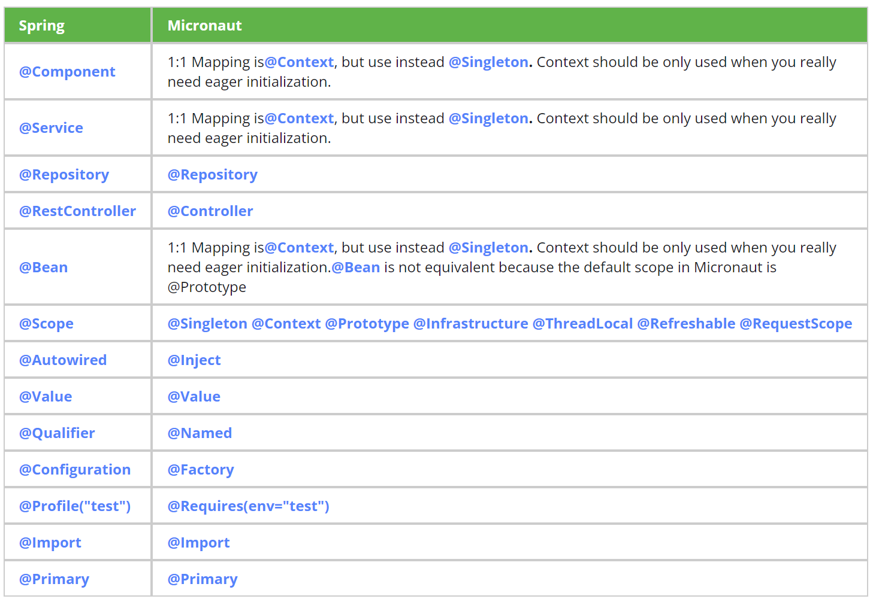
Spring VS Micronaut Annotations

Slide 14
PRESENTATION
AGENDA
Introduction
Micronaut Containers: How it Works
Micronaut Introspection
Scopes
Spring Vs Micronaut Annotations
Setup & First Micronaut Application
Micronaut Launch

Slide 15
SETUP & FIRST MICRONAUT APPLICATION
Please ensure you have Java 8 or higher JDK installed. With Micronaut’s 4.0.0 release, Java 17 is the baseline.
Please go through the following link
https://guides.micronaut.io/latest/creating-your-first-micronaut-app.html

Slide 16
PRESENTATION
AGENDA
Introduction
Micronaut Containers: How it Works
Micronaut Introspection
Scopes
Spring Vs Micronaut Annotations
Setup & First Micronaut Application
Micronaut Launch

Slide 17
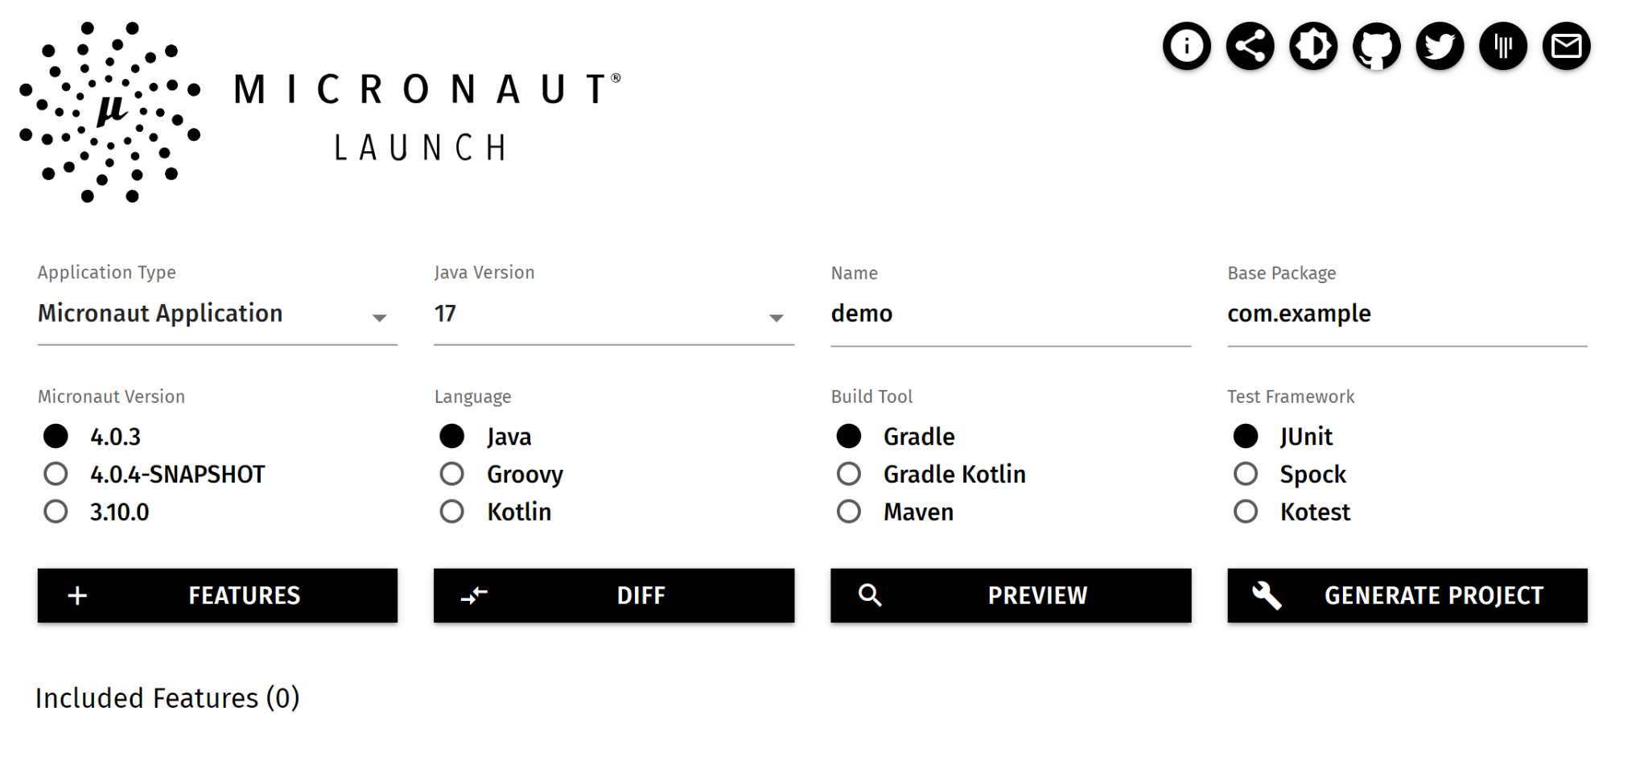
MICRONAUT LAUNCH
https://micronaut.io/launch/

Slide 18
Thank You!

